Slide 1
ONLINE EDUCATION
PLATFORM
FAIROOSA KK
MES21MCA-2010
PRODUCT OWNER: HYDERALI K

Slide 2
TABLE OF CONTENTS
1. Introduction
2. Modules
3. Data Flow Diagram
4. Table Design
5. Product Backlog
6. User Story
7. Project Plans
8. Developing Environment

Slide 3
ONLINE EDUCATION PLATFORM
Technology-based e-learning encompasses the use of the internet and other important technologies to produce materials for learning, teach learners, and also regulate courses in an organization. Typically, e-learning is conducted on the Internet, where students can access their learning materials online at any place and time.
A major benefit hailed by online learning students is that of being able to access learning at their own individual pace and time. The flexibility to access online learning at whatever time is more convenient for the student makes education and ongoing professional training much more available to all types of people, in all types of situations.

Slide 4
MODULES
User:
● User authentication
● Course enrolment
● Profile update
Faculty:
● Authentication
● Course creation
● Listing student details according to the course enrolled.
● Certificate generation on course completion

Slide 5
MODULES
Admin :
● Student listing, Course listing and Enrolment listing
● Add/Delete/Update Courses.
● Course verification.

Slide 6
DATA FLOW DIAGRAM
Level 0
Admin
Online education platform
db
User
Faculty

Slide 7
DATA FLOW DIAGRAM
Level 1.1
View user details
User
Login
View Faculty details
Faculty
Admin
Verification
Course
View feedback
Feedback

Slide 8
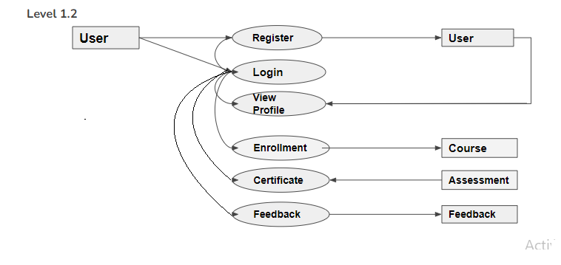
DATA FLOW DIAGRAM

Slide 9
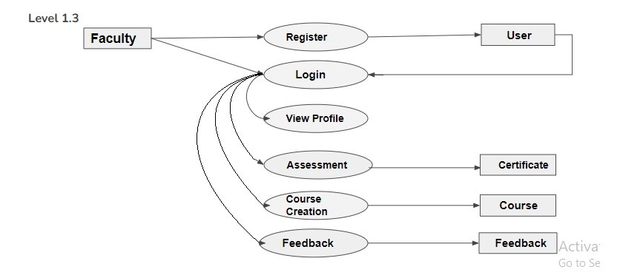
DATA FLOW DIAGRAM

Slide 10
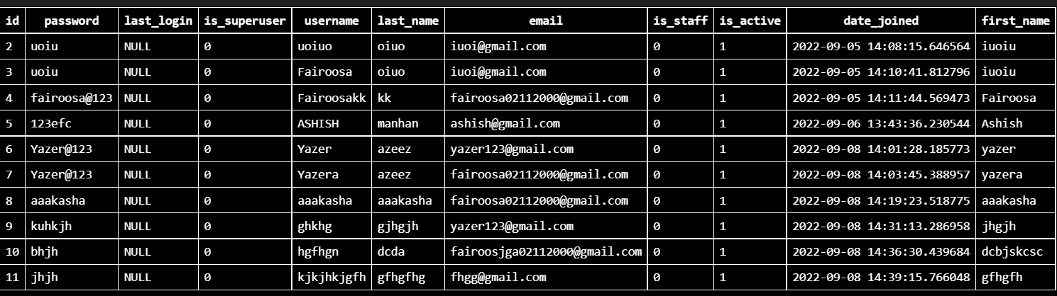
TABLE DESIGN
USER

Slide 11
PRODUCT BACKLOG
ID | NAME | PRIORITY <high/medium/law> | ESTIMATE (Hours) | STATUS <Planned/In progress/Completed>
1 | REGISTRATION | High | 5 | PLANNED
2 | LOGIN | High | 5 | PLANNED
3 | CRUD(Course,Student,University) OPERATIONS | High | 20 | PLANNED
4 | STUDENT ENROLLMENT | High | 10 | PLANNED
5 | CERTIFICATE GENERATION | Medium | 10 | PLANNED

Slide 12
USER STORY
User Story ID | As a type of User | I want to <Perform some task> | So that i can <Achieve Some Goal>
1 | ADMIN | Login | login successful with correct username and password
2 | ADMIN | View and Manage | Can view and Manage registered users,Faculties and Universities
3 | ADMIN | Verification | Verify Courses
4 | USER | Register | Can users register
5 | USER | Login | login successful with correct username and password
6 | USER | Enrollment | Can enroll in any Courses
7 | USER | View Profile | View users profile in application

Slide 13
USER STORY
ID | NAME | I want to <Perform some task> | So that i can <Achieve Some Goal>
8 | USER | Online Assessment | Can attend Assessment
9 | USER | Certificate | Can download the certificate
10 | USER | Feedback | Can provide feedback
11 | FACULTY | Register | Can users register
12 | FACULTY | Login | login successful with correct username and password
13 | FACULTY | View Profile | View users profile in application
14 | FACULTY | Course Creation | Can create course
15 | FACULTY | Feedback | Can view feedback from user

Slide 14
PROJECT PLAN
User StoryID | Task Name | Start Date | End Date | Days | Status
1 | Sprint 1 | 16/08/2022 | 17/08/2022 | 8 | In progress
4 |  | 18/08/2022 | 19/08/2022 |  | In progress
5 |  | 21/08/2022 | 23/08/2022 |  | In progress
11 |  | 25/08/2022 | 26/08/2022 |  | In progress
12 |  | 28/08/2022 | 30/08/2022 |  | In progress
2 | Sprint 2 | 13/09/2022 | 23/09/2022 | 14 | In progress
7 |  | 23/09/2022 | 24/09/2022 |  | In progress
13 |  | 24/09/2022 | 25/09/2022 |  | In progress
14 |  | 25/09/2022 | 27/09/2022 |  | In progress

Slide 15
PROJECT PLAN
User StoryID | Task Name | Start Date | End Date | Days | Status
3 | SPRINT 3 | 03/10/2022 | 06/10/2022 | 14 | In progress
6 |  | 07/10/2022 | 10/10/2022 |  | In progress
8 |  | 13/10/2022 | 20/10/2022 |  | In progress
9 | SPRINT 4 | 28/10/2022 | 5/11/2022 | 14 | In progress
10 |  | 7/11/2022 | 11/11/2022 |  | In progress
15 |  | 13/11/2022 | 15/11/2022 |  | In progress

Slide 16
DEVELOPING ENVIRONMENT
OPERATING SYSTEM : WINDOWS 10
FRONT END : HTML, CSS, JAVASCRIPT, BOOTSTRAP
IDE : VISUAL STUDIO CODE
BACK END : PYTHON
FRAMEWORK : DJANGO
BACK END : SQLite 3

Slide 17
THANK YOU

